Slide 1
TOURISM & HOSPITALITY report
JULIE PINGSTON, CDME, CMP, CTA
PRESIDENT & CEO
Greater lansing convention & visitors bureau

Slide 2
VISION & MISSION STATEMENTS
VISION
MISSION
To inspire visitors and community partners to love Greater Lansing as much as we do.
The mission of the GLCVB is to positively impact our community’s quality of life by developing the region as a visitor destination.

Slide 3
Hotel Rooms sold

Slide 4
occupancy

Slide 5
Average daily rate

Slide 6
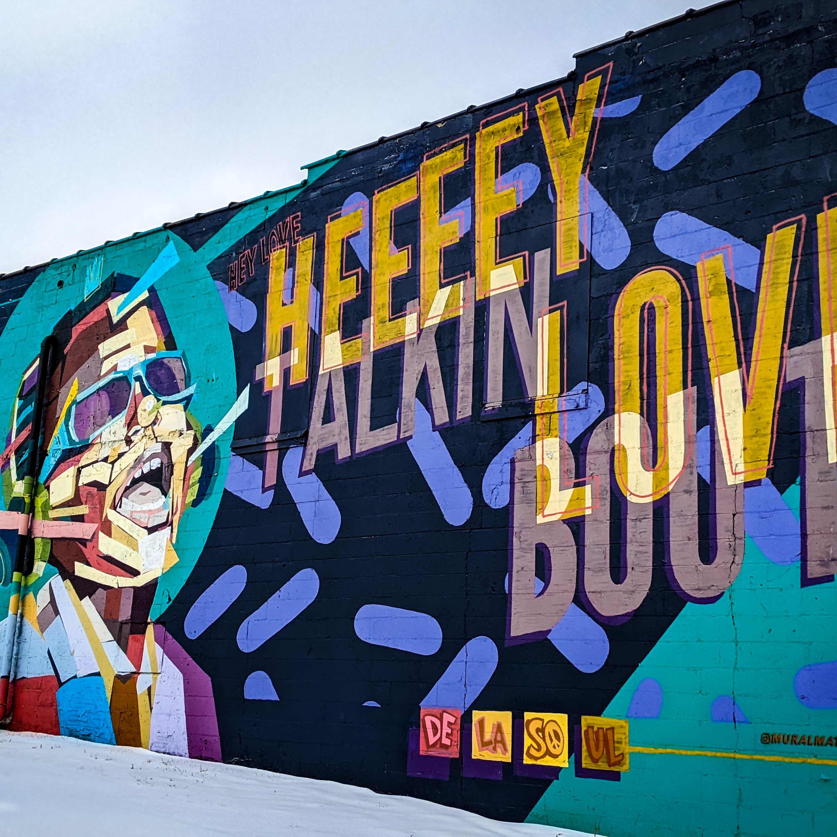
Diversity, equity, accessibility & Inclusion
ADVOCATES FOR ACCESSIBLE TOURISM
TRAVEL ABILITY PARTNERSHIP
SENSORY FRIENDLY PROGRAMS
CULTURE & HERITAGE PROMOTION

Slide 7
2023 downtown lansing riverfront developments
Accessible Playground
NEW Lansing Shuffle
Radisson Renovation
Improved Skywalk

Slide 8
MEETING & COMPETING IN 2023
CONVENTIONS:
Odyssey of the Mind World Finals
Michigan High School Football Coaches Association
mParks
Michigan Association of School Boards
Michigan Science Teachers Association
Michigan Farm Bureau
DIS 2023 (MSU Department of Physics)
SPORTS:
National Horseshoe Pitchers World Championship
NCAA D1 Men’s Golf Regional
NCCAA National Basketball Regional
MHSAA (seven state championship events)
National Clay Target Shooting

Slide 9
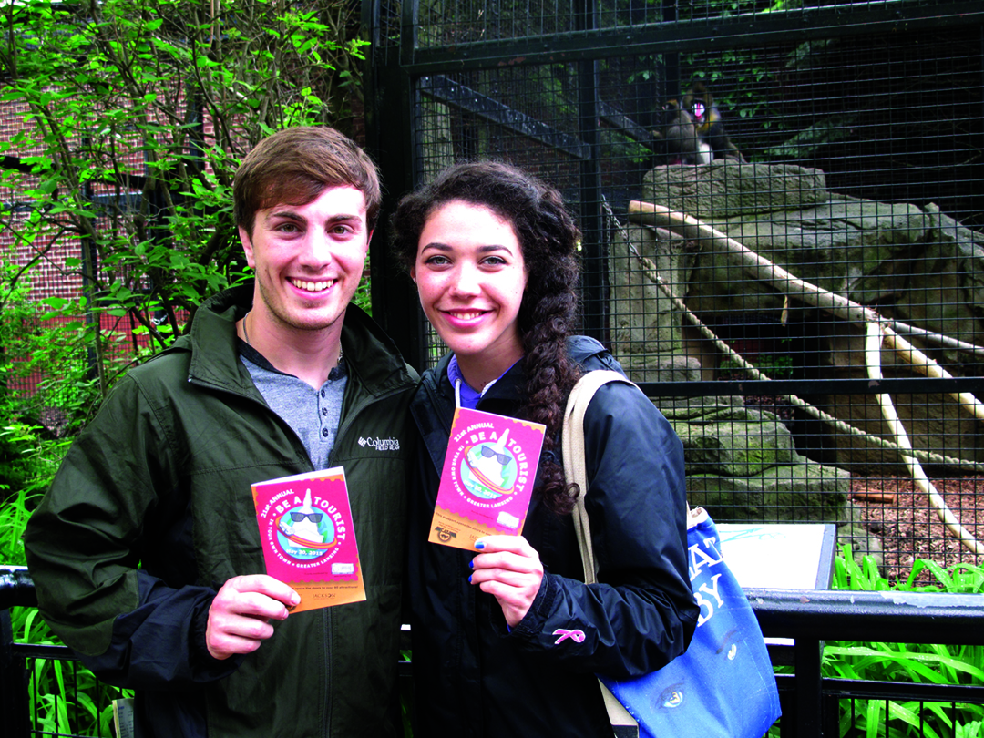
Marketing initiatives
Love Lansing like a local
BATYOT evolution to digital passport

Slide 10
Organization rebrand
STAY TUNED FOR New names & logos
Greatear lansing convention & visitors bureau
Greater lansing sports authority

Slide 11
Thank you
jpingston@lansing.org
http://www.lansing.org

