Slide 1

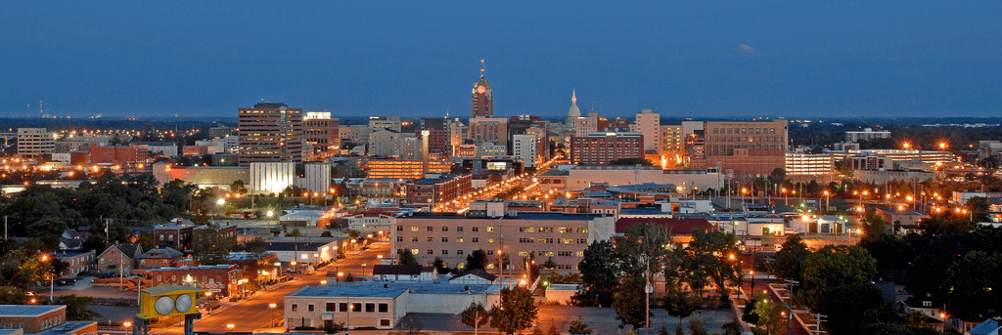
Mid Michigan Economic Forecast
Wednesday, January 11, 2023

Slide 2






Top Issues Impacting Business:
v
v
v
v
v
v
Finding & Keeping Employees
Inflation
Supply Chain Disruptions
Growing Revenue
Regional Economy
Housing
67%
50%
30%
30%
25%
20%

Slide 3






Top Public Policy Issues of 2023:
v
v
v
v
v
v
Economic Development & Job Creation
Talent & Education
Infrastructure
Healthcare Accessibility & Affordability
Public Safety
Taxation
Housing
75%
51%
36%
29%
29%
29%

Slide 4



What talent and workforce-related issues are you currently experiencing?
Retaining New Employees
Retaining Long-Term Employees
Increased Cost for Salary and Other Benefits
Other Workforce-Related Issues
Other
63%
Lack of Applicants
Lack of Applicants
with Necessary Skills
Lack of Applicants Willing to Accept
a Job
28%
60%
67%
26%
16%
42%
12%

Slide 5




Have you made any changes to employee compensation, benefits or work hours due to the difficulty attracting workers?
More Flexibility, Including Remote or Hybrid Work
Increased Compensation
New or Improved Employee Benefits
Professional Development, Skills Training
Other
70%
84%
40%
51%
2%

Slide 6

Political Leadership
Capitol Caucus
Leading Forward
ARPA Dollars
Heritage Hall
Public Safety

Slide 7
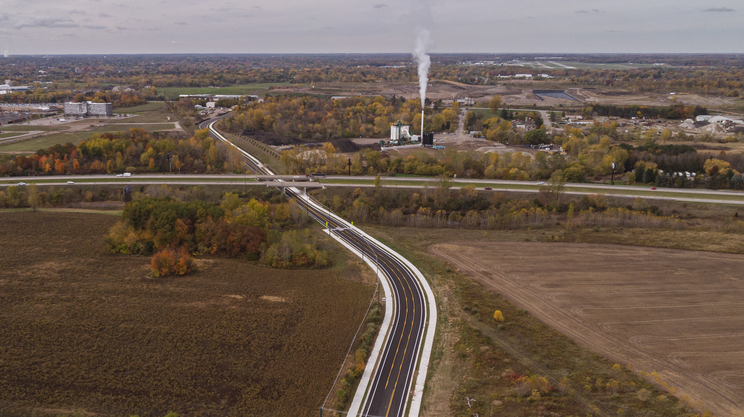
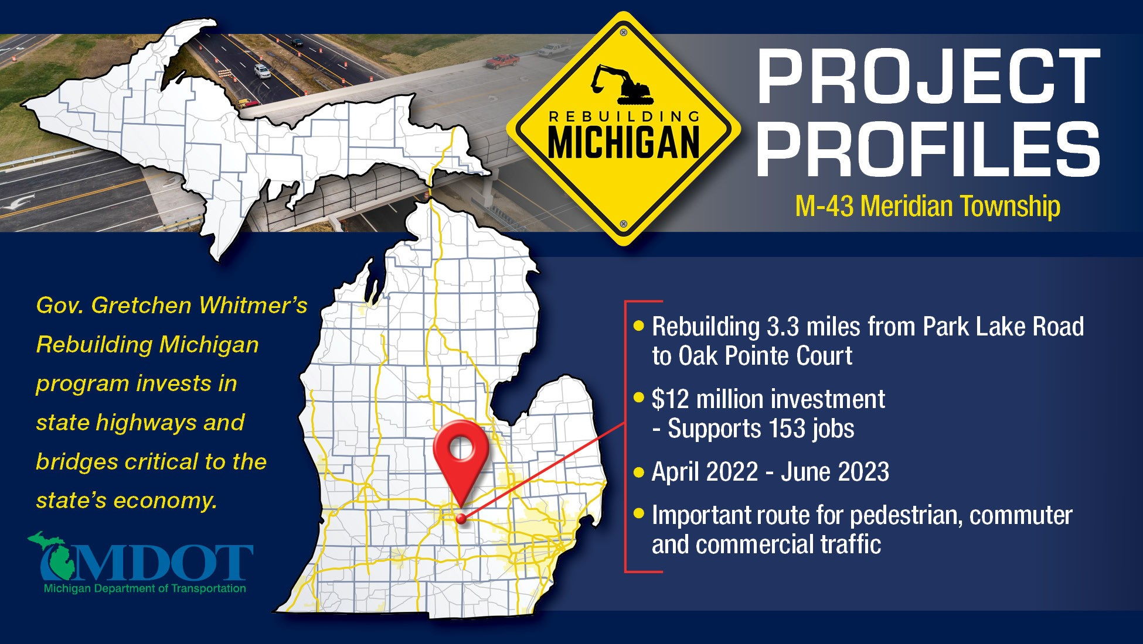

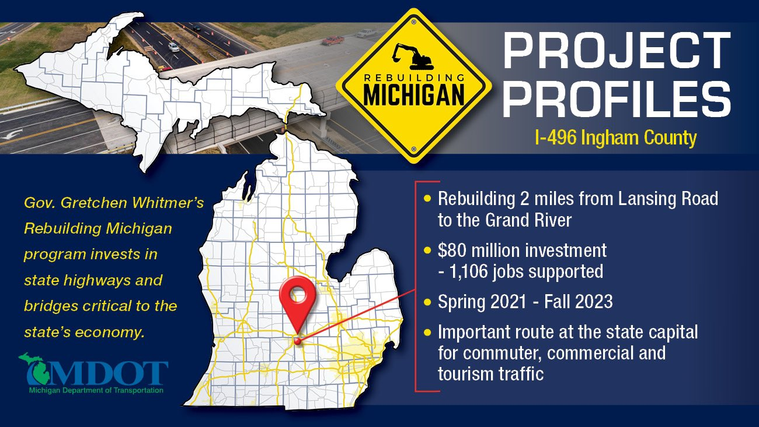



Slide 8
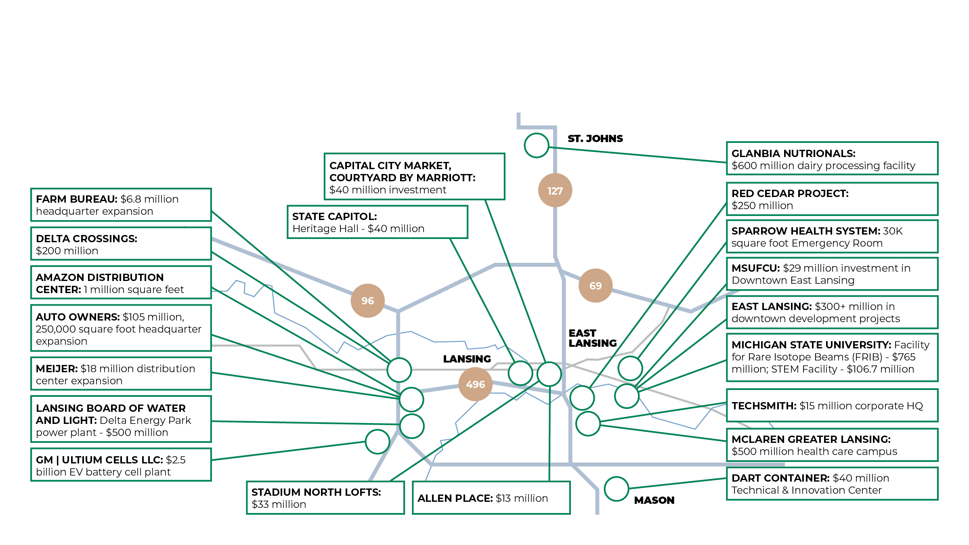
US127 Corridor Regional Development

Slide 9

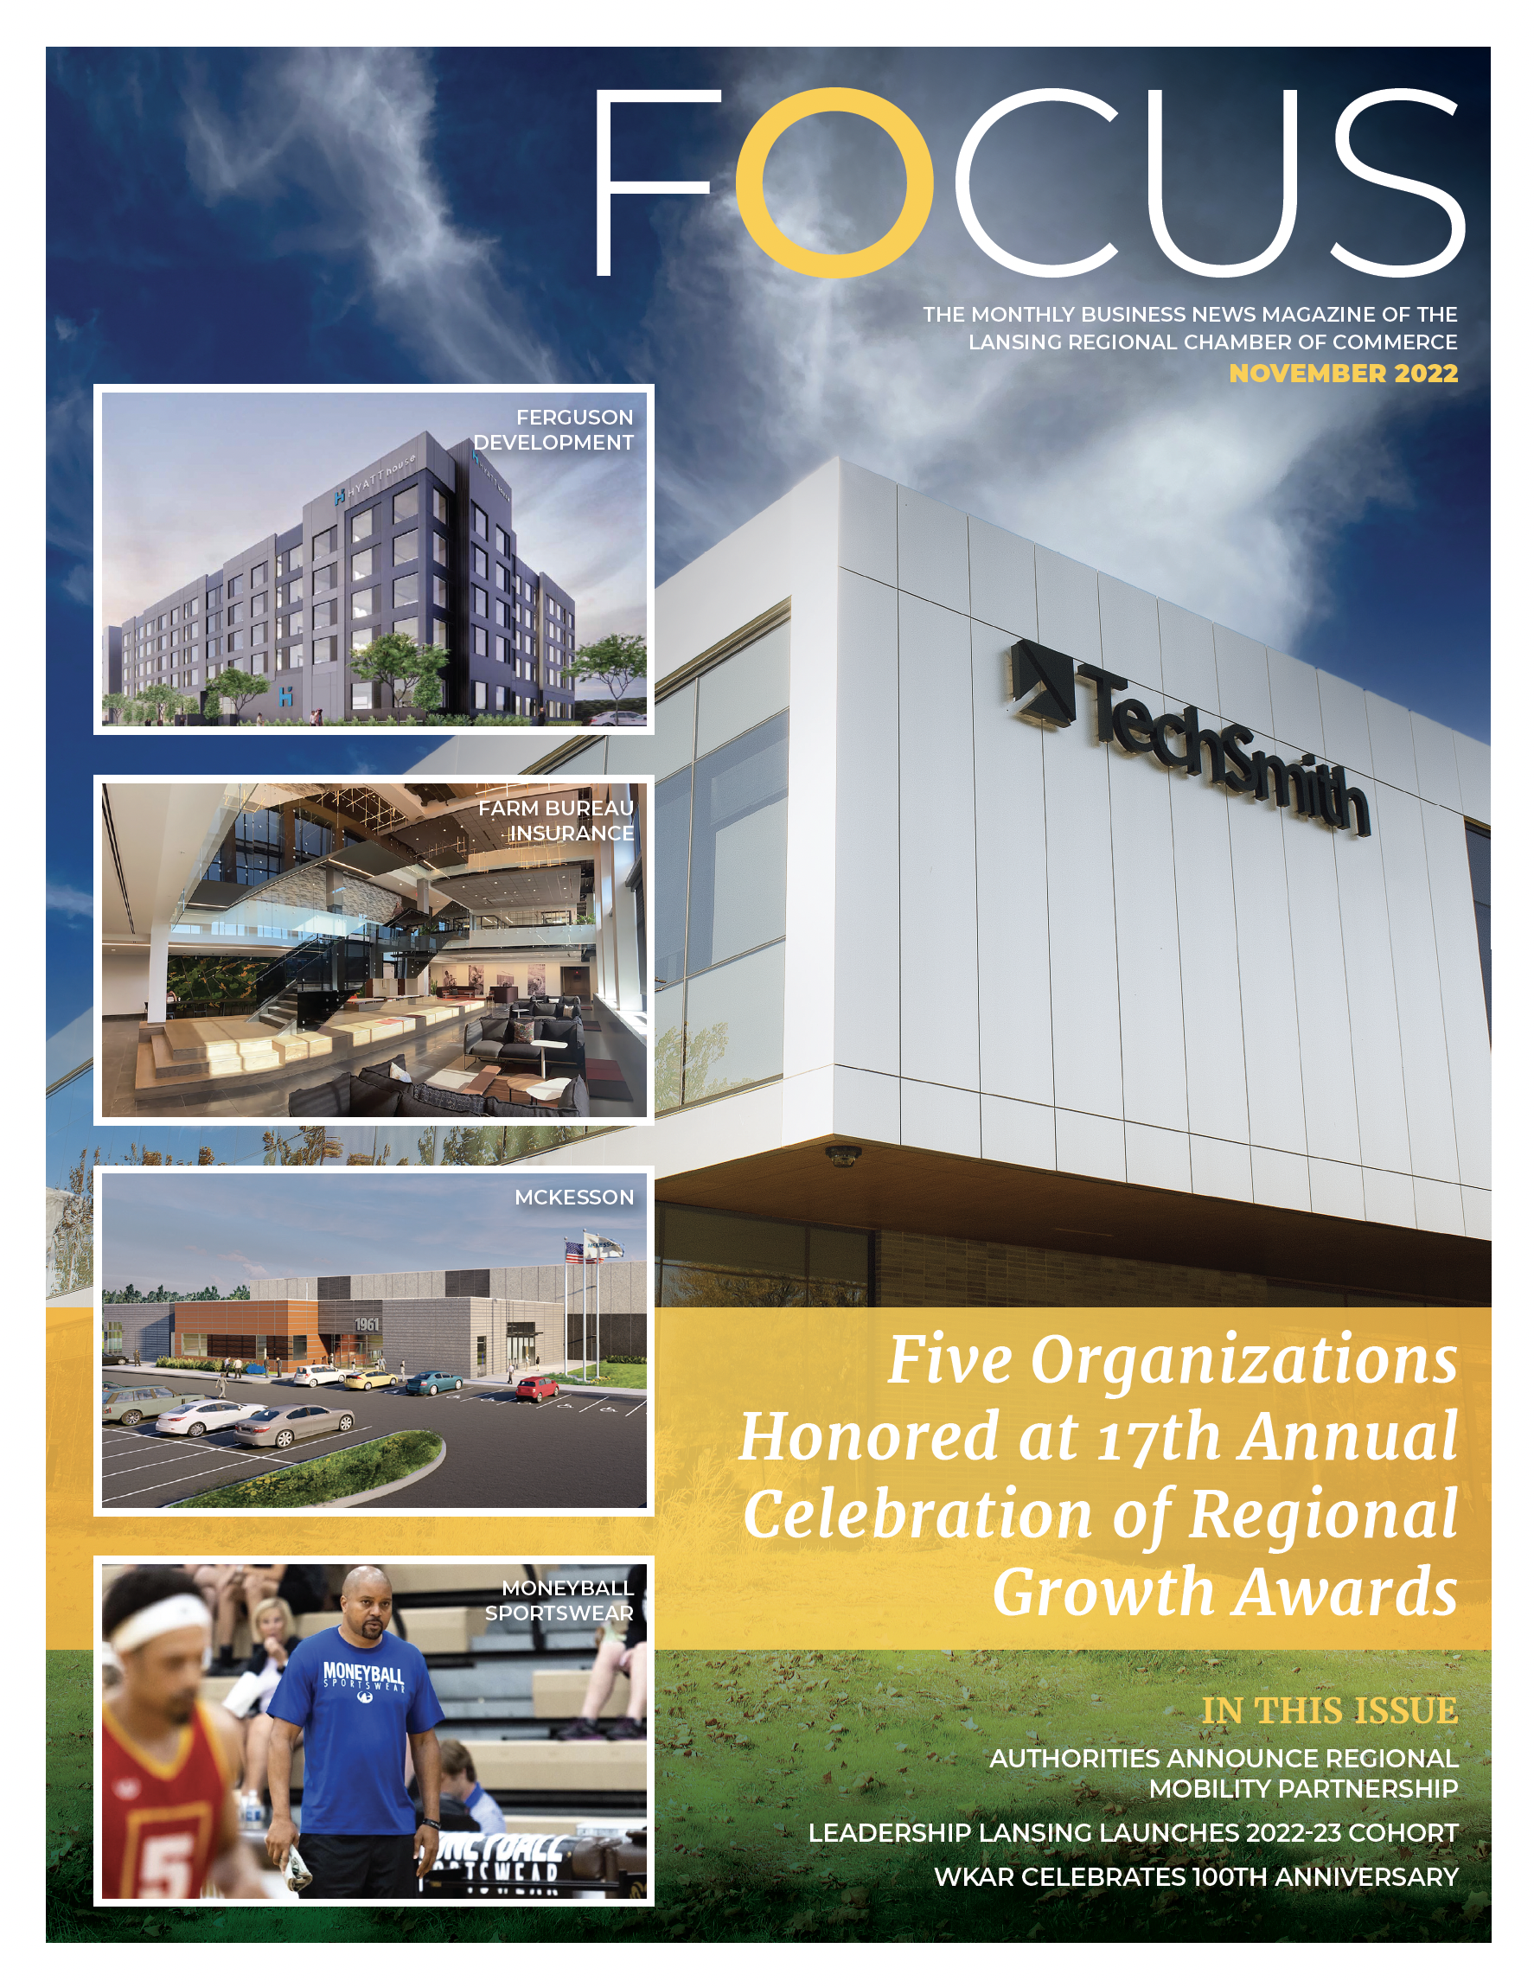
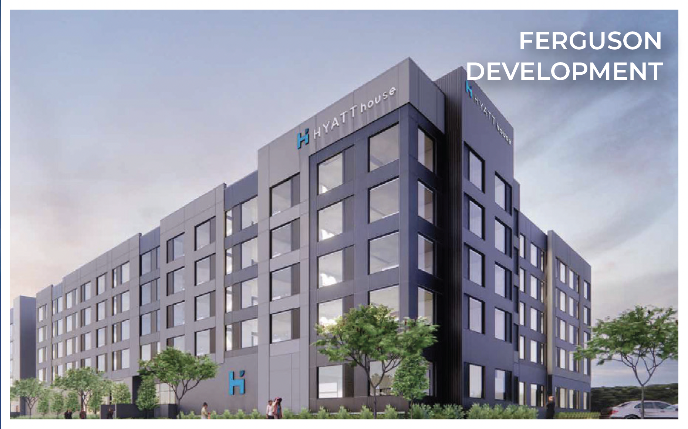
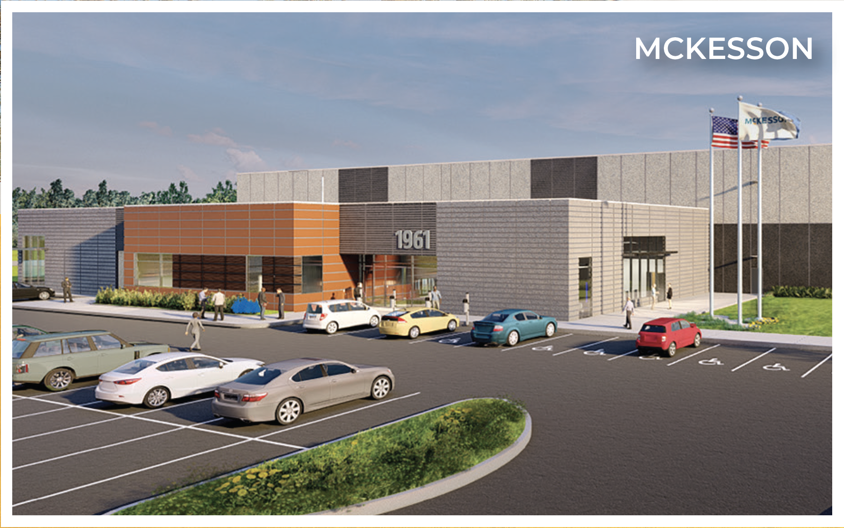



Slide 10

2023 Looking Forward
Housing
Public Transportation
Childcare
Economic Development
US Senate Seat
Downtown Lansing
Legislative Priorities
  EITC
  Retiree Pension Tax
  Right to Work
  Minimum Wage | Paid Sick Leave
  Auto No Fault
Economy
  Job Growth
  Inflation
  Recession

Slide 11

Join us in building a more vibrant region!

