Slide 1
2023 Regional Economic Forecast Bob Trezise, President and CEO Lansing Economic Area Partnership

Slide 2
2022 LEAP Economic Development Impact Summary

Slide 3
Business Attraction
3 industry attraction projects : Ultium Cells LLC; ATESTEO; A Plus International Culture Communications, Inc.
$2.63B investment
1,752 jobs
3 industry expansion projects secured: General Motors; NEOGEN; Consumers Energy
$626.1M investment
77 new jobs
$23.41 average wage of 1,829 new jobs from industry projects.
Over 1,300 acre megasite assembled via LEAP-controlled options.
With DEEP Dept, continuous building of Ultium and Regional People Infrastructure plans.
$69.5M in state Ultium/Megasite and site readiness and infrastructure grant dollars administered by LEAP.
$250 million Site Readiness law passed, benefits additional major industrial sites in our region for site prep.
Successfully submitted to the EPA for a new Regional Brownfield Coalition $500,000 grant.
Securing significant regional childcare grant/Housing meetings/Public Transportation plans regionally.
First Medtech gameplan strategy for region created.
M-21 AgTech Corridor branding & marketing content completed.

Slide 4
Equitable Economic Development
Assisted over 30 Black and Hispanic small businesses through the LevelUp Program which supported LLC formations, accounting systems, and convent documentation.
Launched and completed our inaugural pilot of Elevate in partnership with PNC, graduating 7 Black-owned businesses with a goal of increasing revenue, profitability and prominence.
Launched the Leave a Legacy program under the Ingham Sunrise contract, to promote small business succession planning with an emphasis on worker-owner cooperative model.
Launched Small Business Boost program in partnership with city of Lansing’s office of Financial Empowerment, were we held a total of 104 financial/budget sessions comprised from 47 small business owners.
Partnered with the Lansing Regional Chamber of Commerce to award the inaugural Diversity Star Award to Peckham.
Completed six One and All programs and graduated nearly 120 entrepreneurs; 100+ jobs created or retained across all programs, 9 new brick and mortar location openings, and more than half a million dollars in follow-on investment.

Slide 5
High-tech Entrepreneurship
Distributed $9,000 in startup capital to winners across three Hatching events.
Successful completion and enactment of a contract between LEAP and SmartZone, hiring a full-time Director.
2022 TIF Renewal resulting in additional 5 years of tax capture funding for the Lansing Regional SmartZone.
Successful passing and execution of the 22/23 Lansing Regional SmartZone spending plan which allocated 450,000 in funding for crucial high growth companies.
Engagement with over 100 startups and corporates including Airbnb to invest in the future of tech programs and resources for the future.
Secured eight Business Accelerator Fund awards, including discretionary, totaling $85,320.
Follow-on investment totaling $5,134,000 from a variety of sources (SBIR/STTR, DARPA, Pitch competitions, Accelerator investments, etc.).

Slide 6
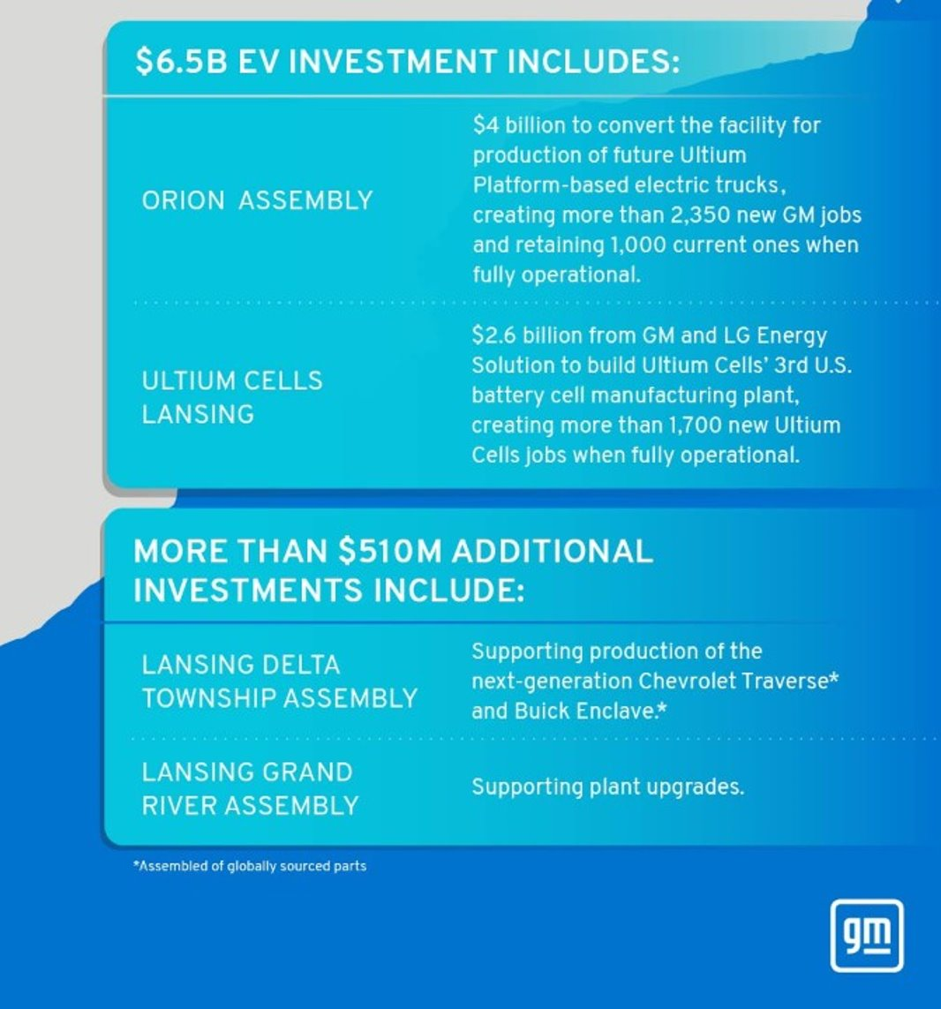
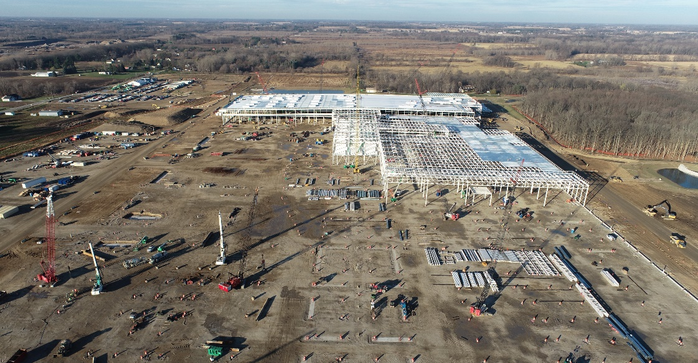
GM Lansing Grand River & Lansing Delta Township Assembly Plants
4,200
250,000
Employees
Final assembly of vehicles per year
Lansing home to two newest US GM assembly plants
Ultium Cells announced a $2.6 billion investment to build its third US battery cell manufacturing plant​
2.5 million square foot plant underway on 600 acres
Largest Ultium plant in America
Expected to create 1,700 ​new jobs
Securing the future of the mobility industry​

Slide 7
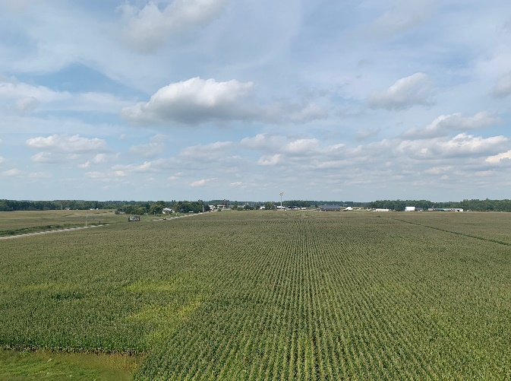
America’s Best Site
The Michigan Manufacturing Innovation Campus
1,300+ acres controlled by LEAP
Primed for Energy Heavy Mega Projects
Adjacent to I-96 interstate
Site is within 1.5 hours of 4 international airports, and within 4 hours of 1 top-10 cargo airport
20 Minutes from state capital and Michigan State University

Slide 8
Traditional Infrastructure Needs and Incentives
Wastewater, water capacity, electricity, roads

Slide 9
People Infrastructure
Supporting and developing high-quality people infrastructure amenities and systems for successful job and company attraction and growth.
Transit
Childcare
Attainable Housing
Diversity of Skilled Workforce
Educational Attainment
Placemaking

Slide 10
Real Estate Issues
Lansing-area doesn’t have available major industrial buildings
Land lots are not ready
Infrastructure sometimes not ready or is very expensive
For the very largest projects, prospects are demanding the site be publicly owned

Slide 11
Bob Trezise
President and CEO, LEAP
Bob@purelansing.com
1.517.285-6360

