Slide 1
TOURISM & HOSPITALITY
REPORT
JULIE PINGSTON, CDME, CMP, CTA
PRESIDENT & CEO
CHOOSE LANSING

Slide 2

Vision
To inspire visitors and community partners to love Greater Lansing as much as we do.
Mission
The mission of Choose Lansing is to positively impact our community’s quality of life by developing the region as a visitor destination.

Slide 3


Organization Rebrand

Slide 4
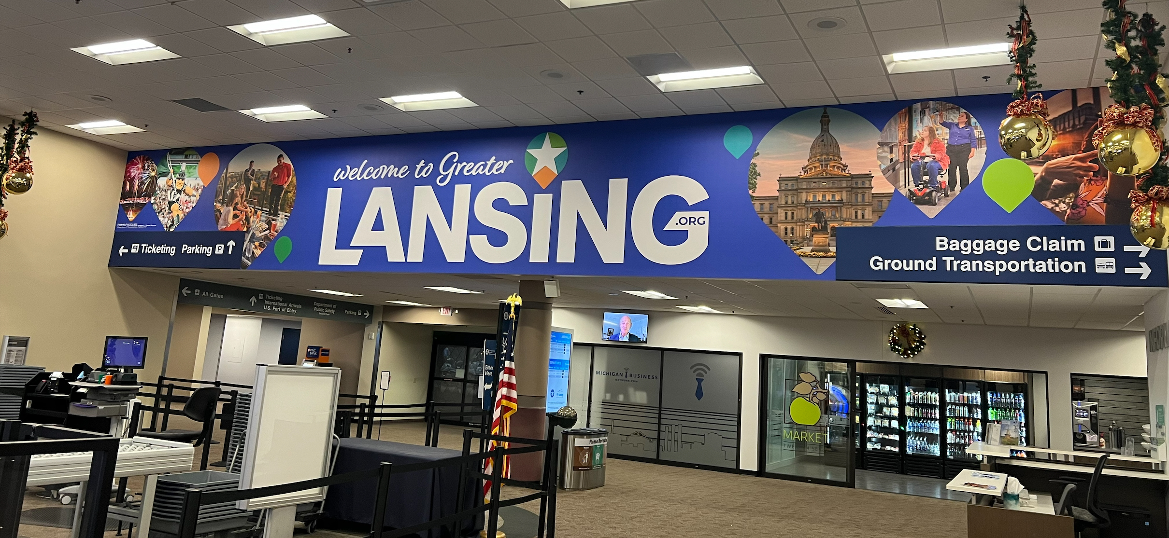
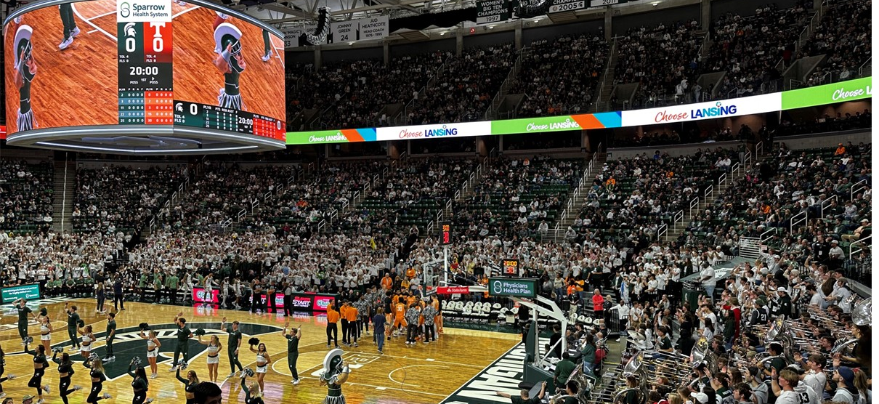

Marketing Initiatives
Community Engagement
Love Lansing Like a Local
Digital Passes

Slide 5
2023 Market Review

Slide 6
Hotel Rooms Sold
1,060,047
1,049,003

Slide 7
Regional Hotel Occupancy
61.6%
53.8%
734 rooms added to the market since 2019
2021 Courtyard by Marriott Downtown
Graduate Hotel East Lansing
2023 AC Hotel by Marriott & Hyatt House
WoodSpring Suites

Slide 8
Occupancy

Slide 9
Average Daily Rate

Slide 10
2024 Market Review

Slide 11
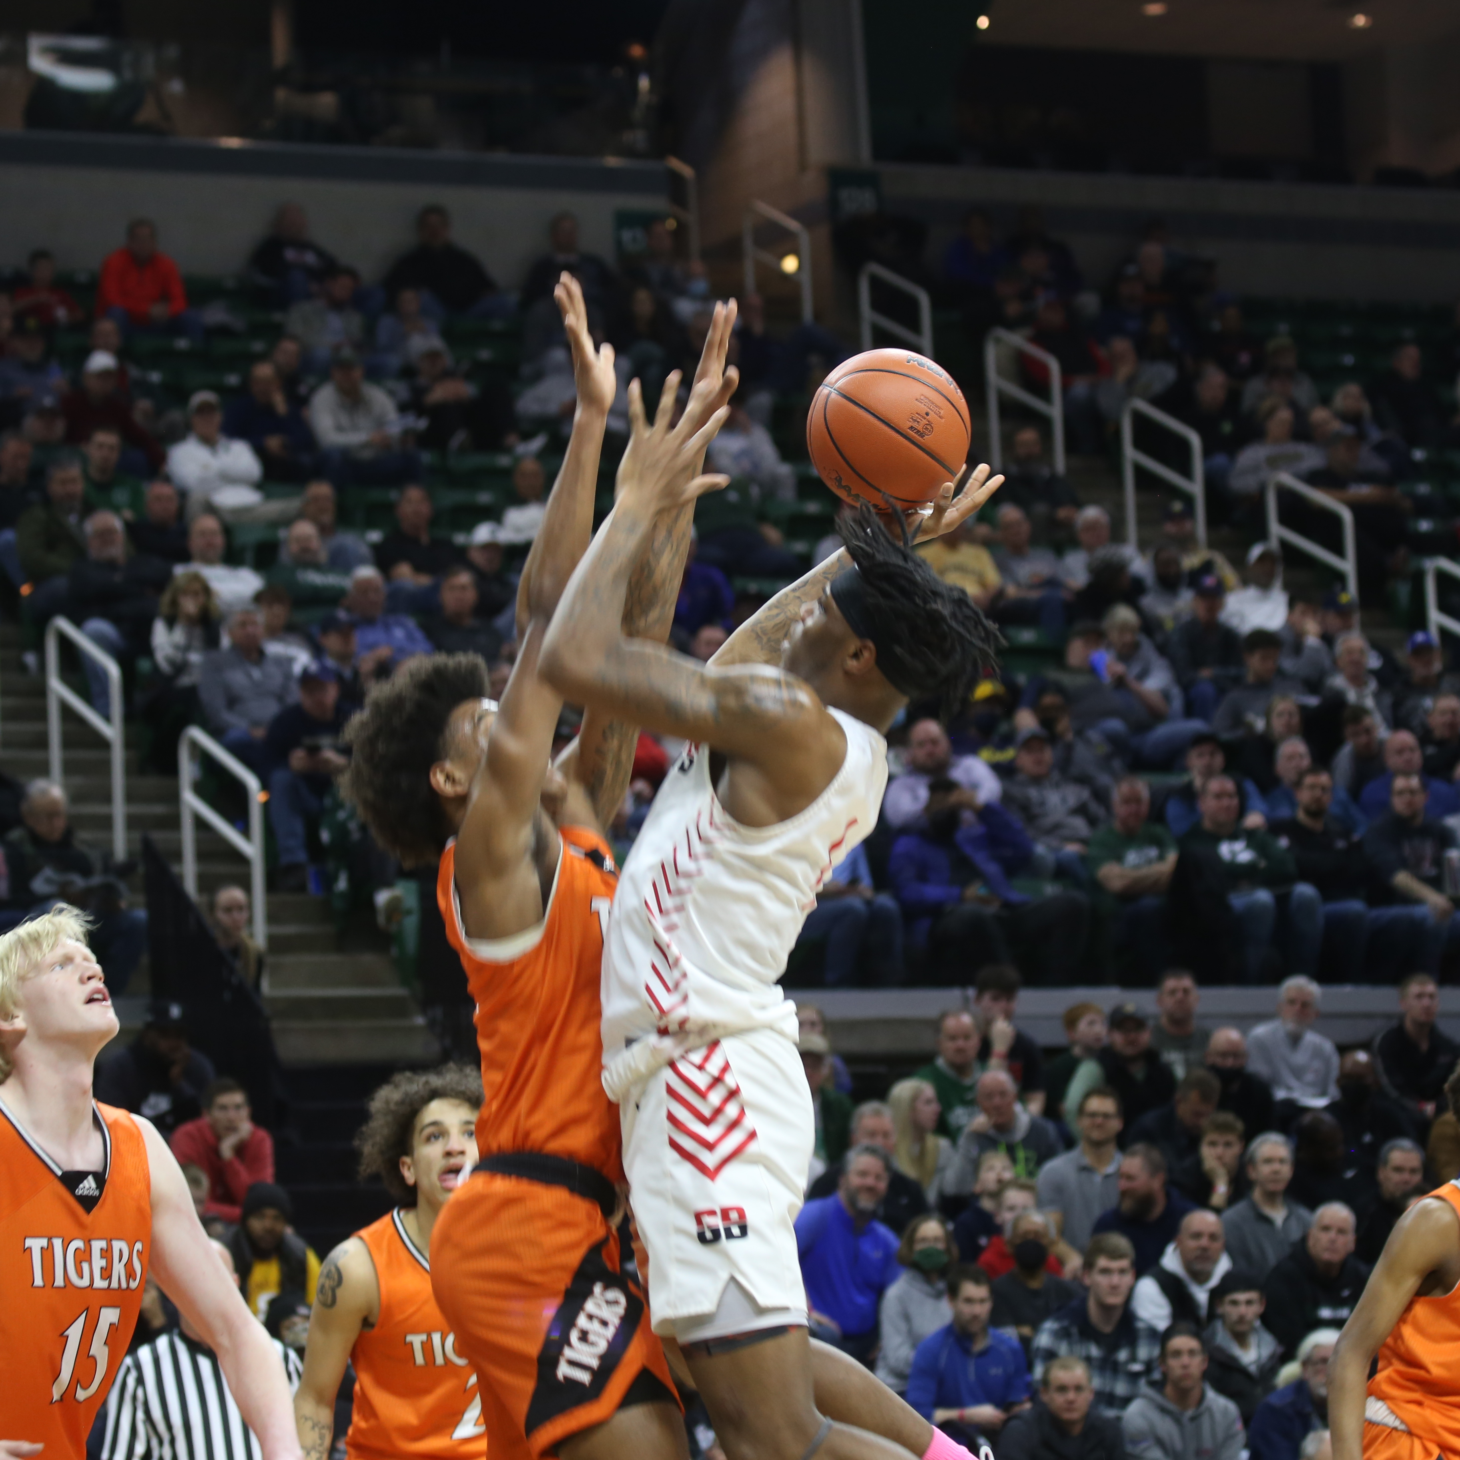
Meeting & Competing in 2024
CONVENTIONS:
Michigan High School Football Coaches Association
Michigan Association of School Boards
Michigan Science Teachers Association
Eli Broad College of Business International Immersion Program (Mumbai, India)
LARA's Joint Providers Surveyors Training
SPORTS:
NCAA D1 Women’s Golf Regional
USA Hockey Tier II Girls 19U National Championships
USA Taekwondo Grand Prix Eastern Regionals
NCCAA National Basketball Regional
MHSAA (seven state championship events)
USA High School Clay Target Nationals

Slide 12
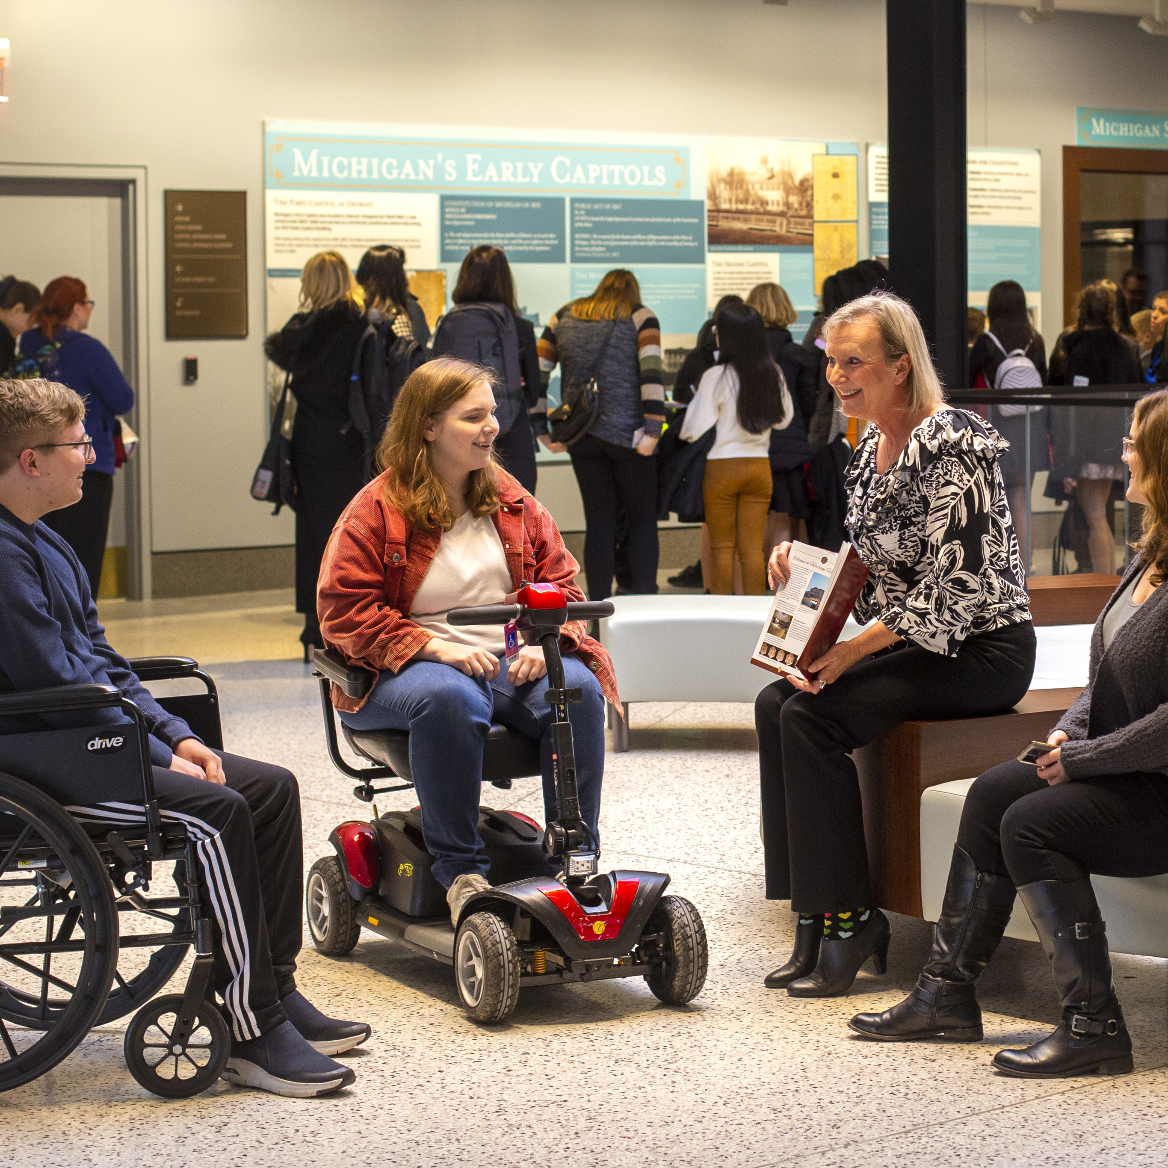
Diversity, Equity, Accessibility & Inclusion
Advocates for Accessible Tourism
Travel Ability Partnership
Sensory Inclusive Programs
Culture & Heritage Promotion

Slide 13
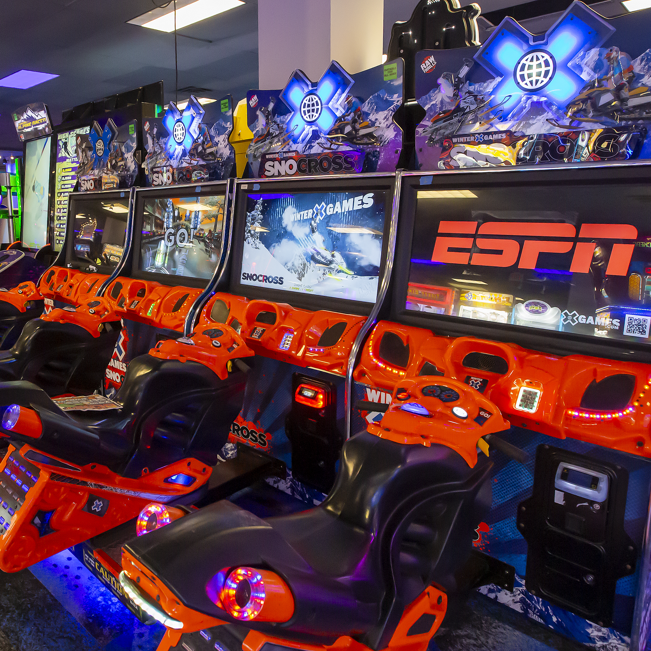
2024 New Developments
HOTELS
210 additional hotel rooms
Towneplace Suites (Wood Road)
Staybridge Suites (Wood Road)
RESTAURANTS
Bobcat Bonnie’s
The Macotta Club
Lansing Shuffle
Summerlands Brewing
ATTRACTIONS
Zap Zone XL
MSU Museum
State Capitol Tours
Light Show Downtown
New Festival - Rock Lansing
SPORT FACILITIES

Slide 14
THANK YOU
JULIE PINGSTON, CDME, CMP, CTA
PRESIDENT & CEO
jpingston@lansing.org
Lansing.org

