Slide 1





MID-MICHIGAN
ECONOMIC
FORECAST
THURSDAY, JANUARY 11, 2024

Slide 2









Q4 2023 SMALL BUSINESS INDEX
TALENT
SKILLED LEGAL IMMIGRANTS
INFLATION
REGIONAL ECONOMY GOOD HEALTH
GROWING REVENUE
SUPPLY CHAIN DISRUPTIONS
60%
54%
53%
30%
22%
17%

Slide 3






TOP BUSINESS CONCERNS
ECONOMIC DEVELOPMENT & JOB CREATION
TALENT AND EDUCATION
INFRASTRUCTURE
HEALTHCARE ACCESSIBILITY & AFFORDABILITY
PUBLIC SAFETY
TAXATION
HOUSING
75%
51%
36%
29%
29%
29%

Slide 4
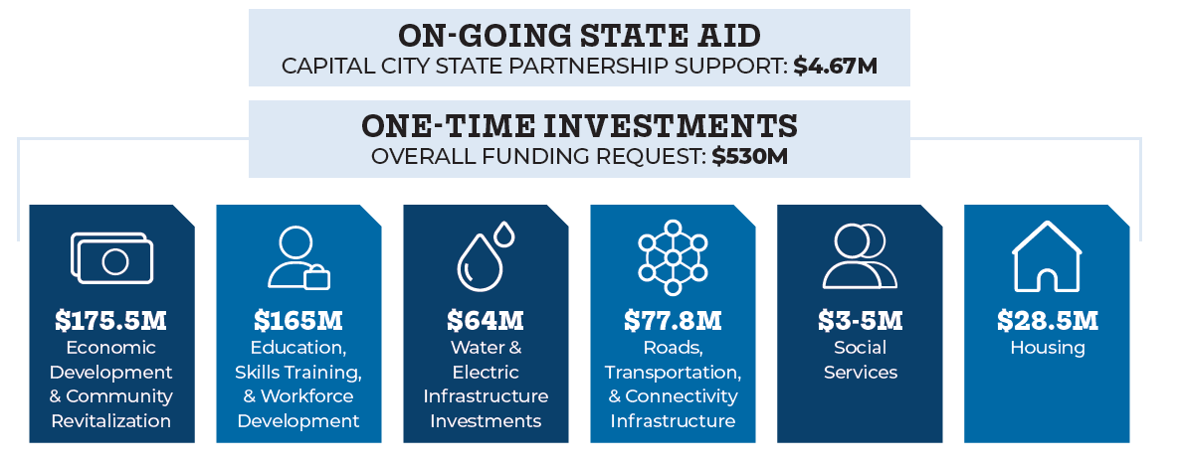
CRISP

Slide 5



Slide 6
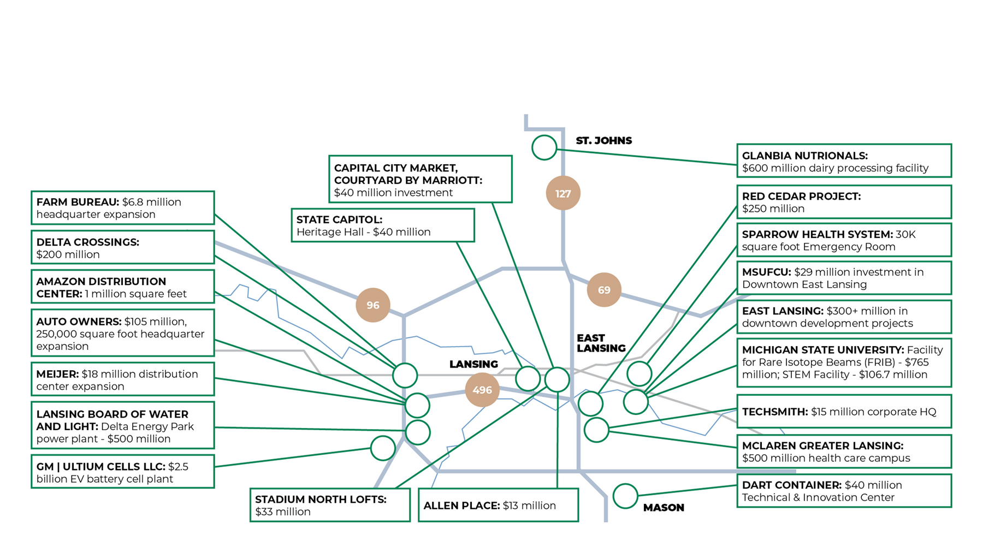
US 127 CORRIDOR REGIONAL DEVELOPMENT

Slide 7
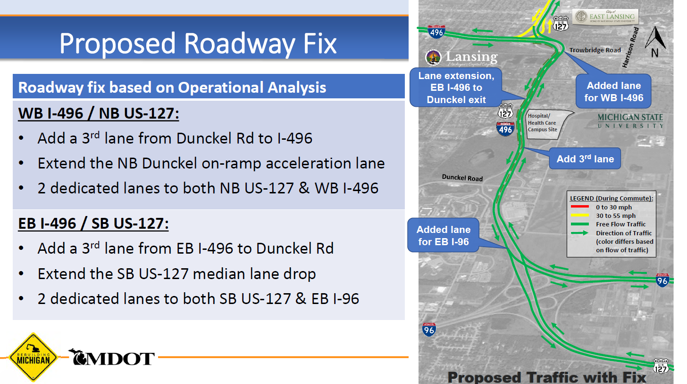

Slide 8
LOOKING AHEAD IN 2024
CITY OF LANSING CHARTER COMMISSION
ELECTIONS
-PRESIDENTIAL
-US SENATE
-7TH CONGRESSIONAL
REGIONAL
HEALTH CARE
STATE BUDGET DOLLARS
MSU PRESIDENT

Slide 9


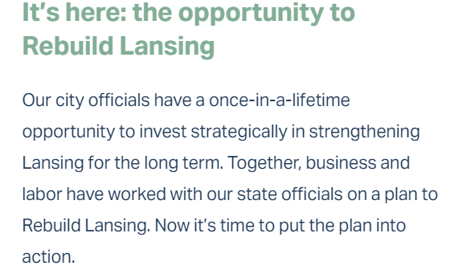

Slide 10


