Slide 1
Lansing Economic Area Partnership
2023 Review – 2024 Goals

Slide 2
2023 LEAP PROJECTS
$111,750,000 – LEAP Projects = Total Private Investment
$77,950,000 – Attraction Project Investment
$25,400,000 – Expansion Project Investment
$8,400,000 – Entrepreneurial Client Follow-on Investment
509 – LEAP Total Job Creation
245 – Attraction Project Job Creation
256 – Expansion Project Job Creation
8 – Entrepreneurial Client Job Creation
$23.90 – Average Wage (Attraction / Expansion Industry Projects)
35 Quality New Company Formations with Entrepreneurial Clients

Slide 3
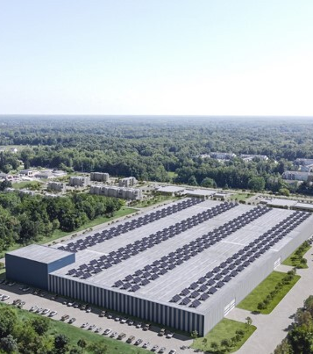
ATTRACTION RESULTS 2023
1 largescale FDI
Norm Fasteners in Bath Twp (Turkey)
3 FDI soft landing
Gintech (South Korea)
Yiqi Intelligent Equipment Co., Ltd (China)
Qingdao OCI Industrial Co. Ltd (China)
Norm Fasteners in Bath Township

Slide 4
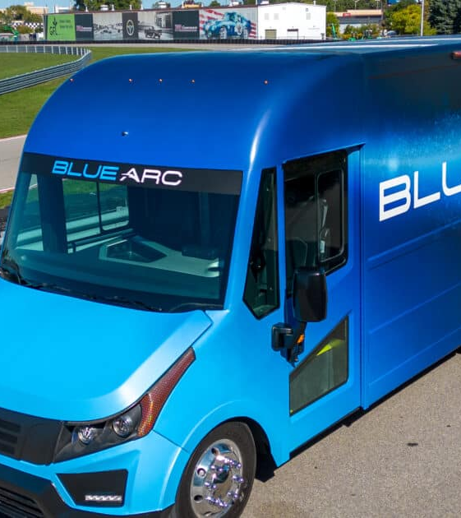
EXPANSION RESULTS 2023
Shyft Group
Molded Plastics Inc
Midwest Press & Automation

Slide 5
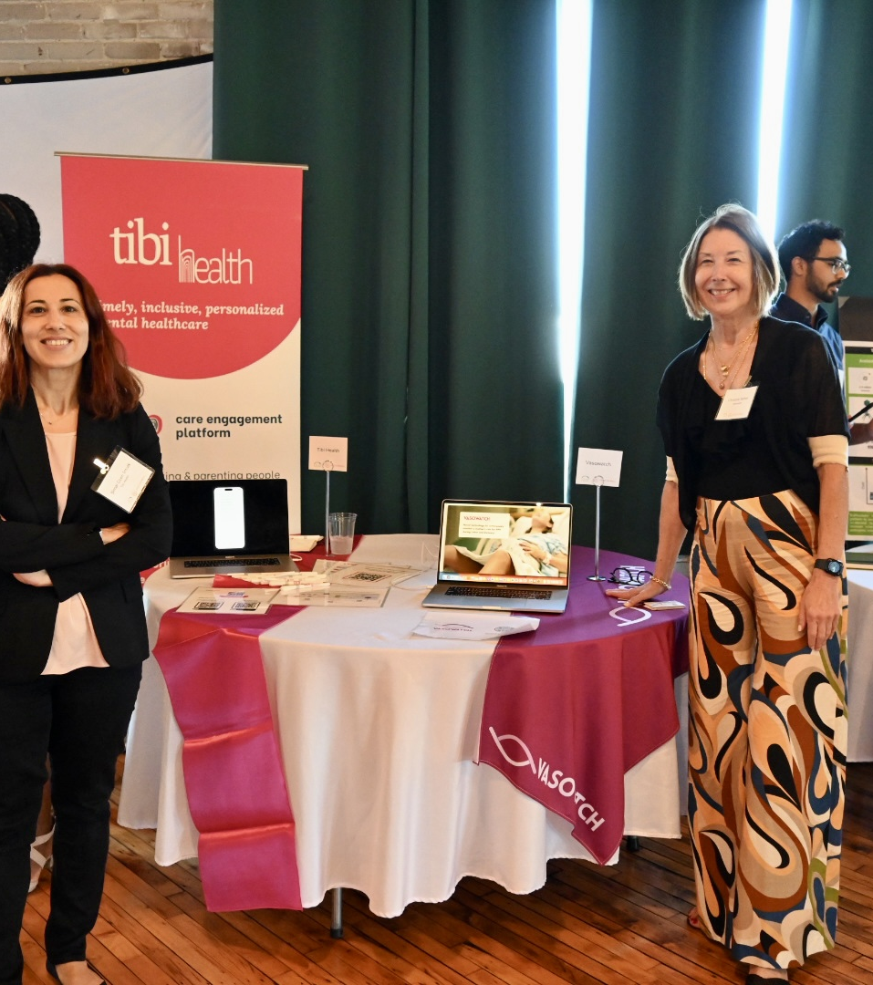
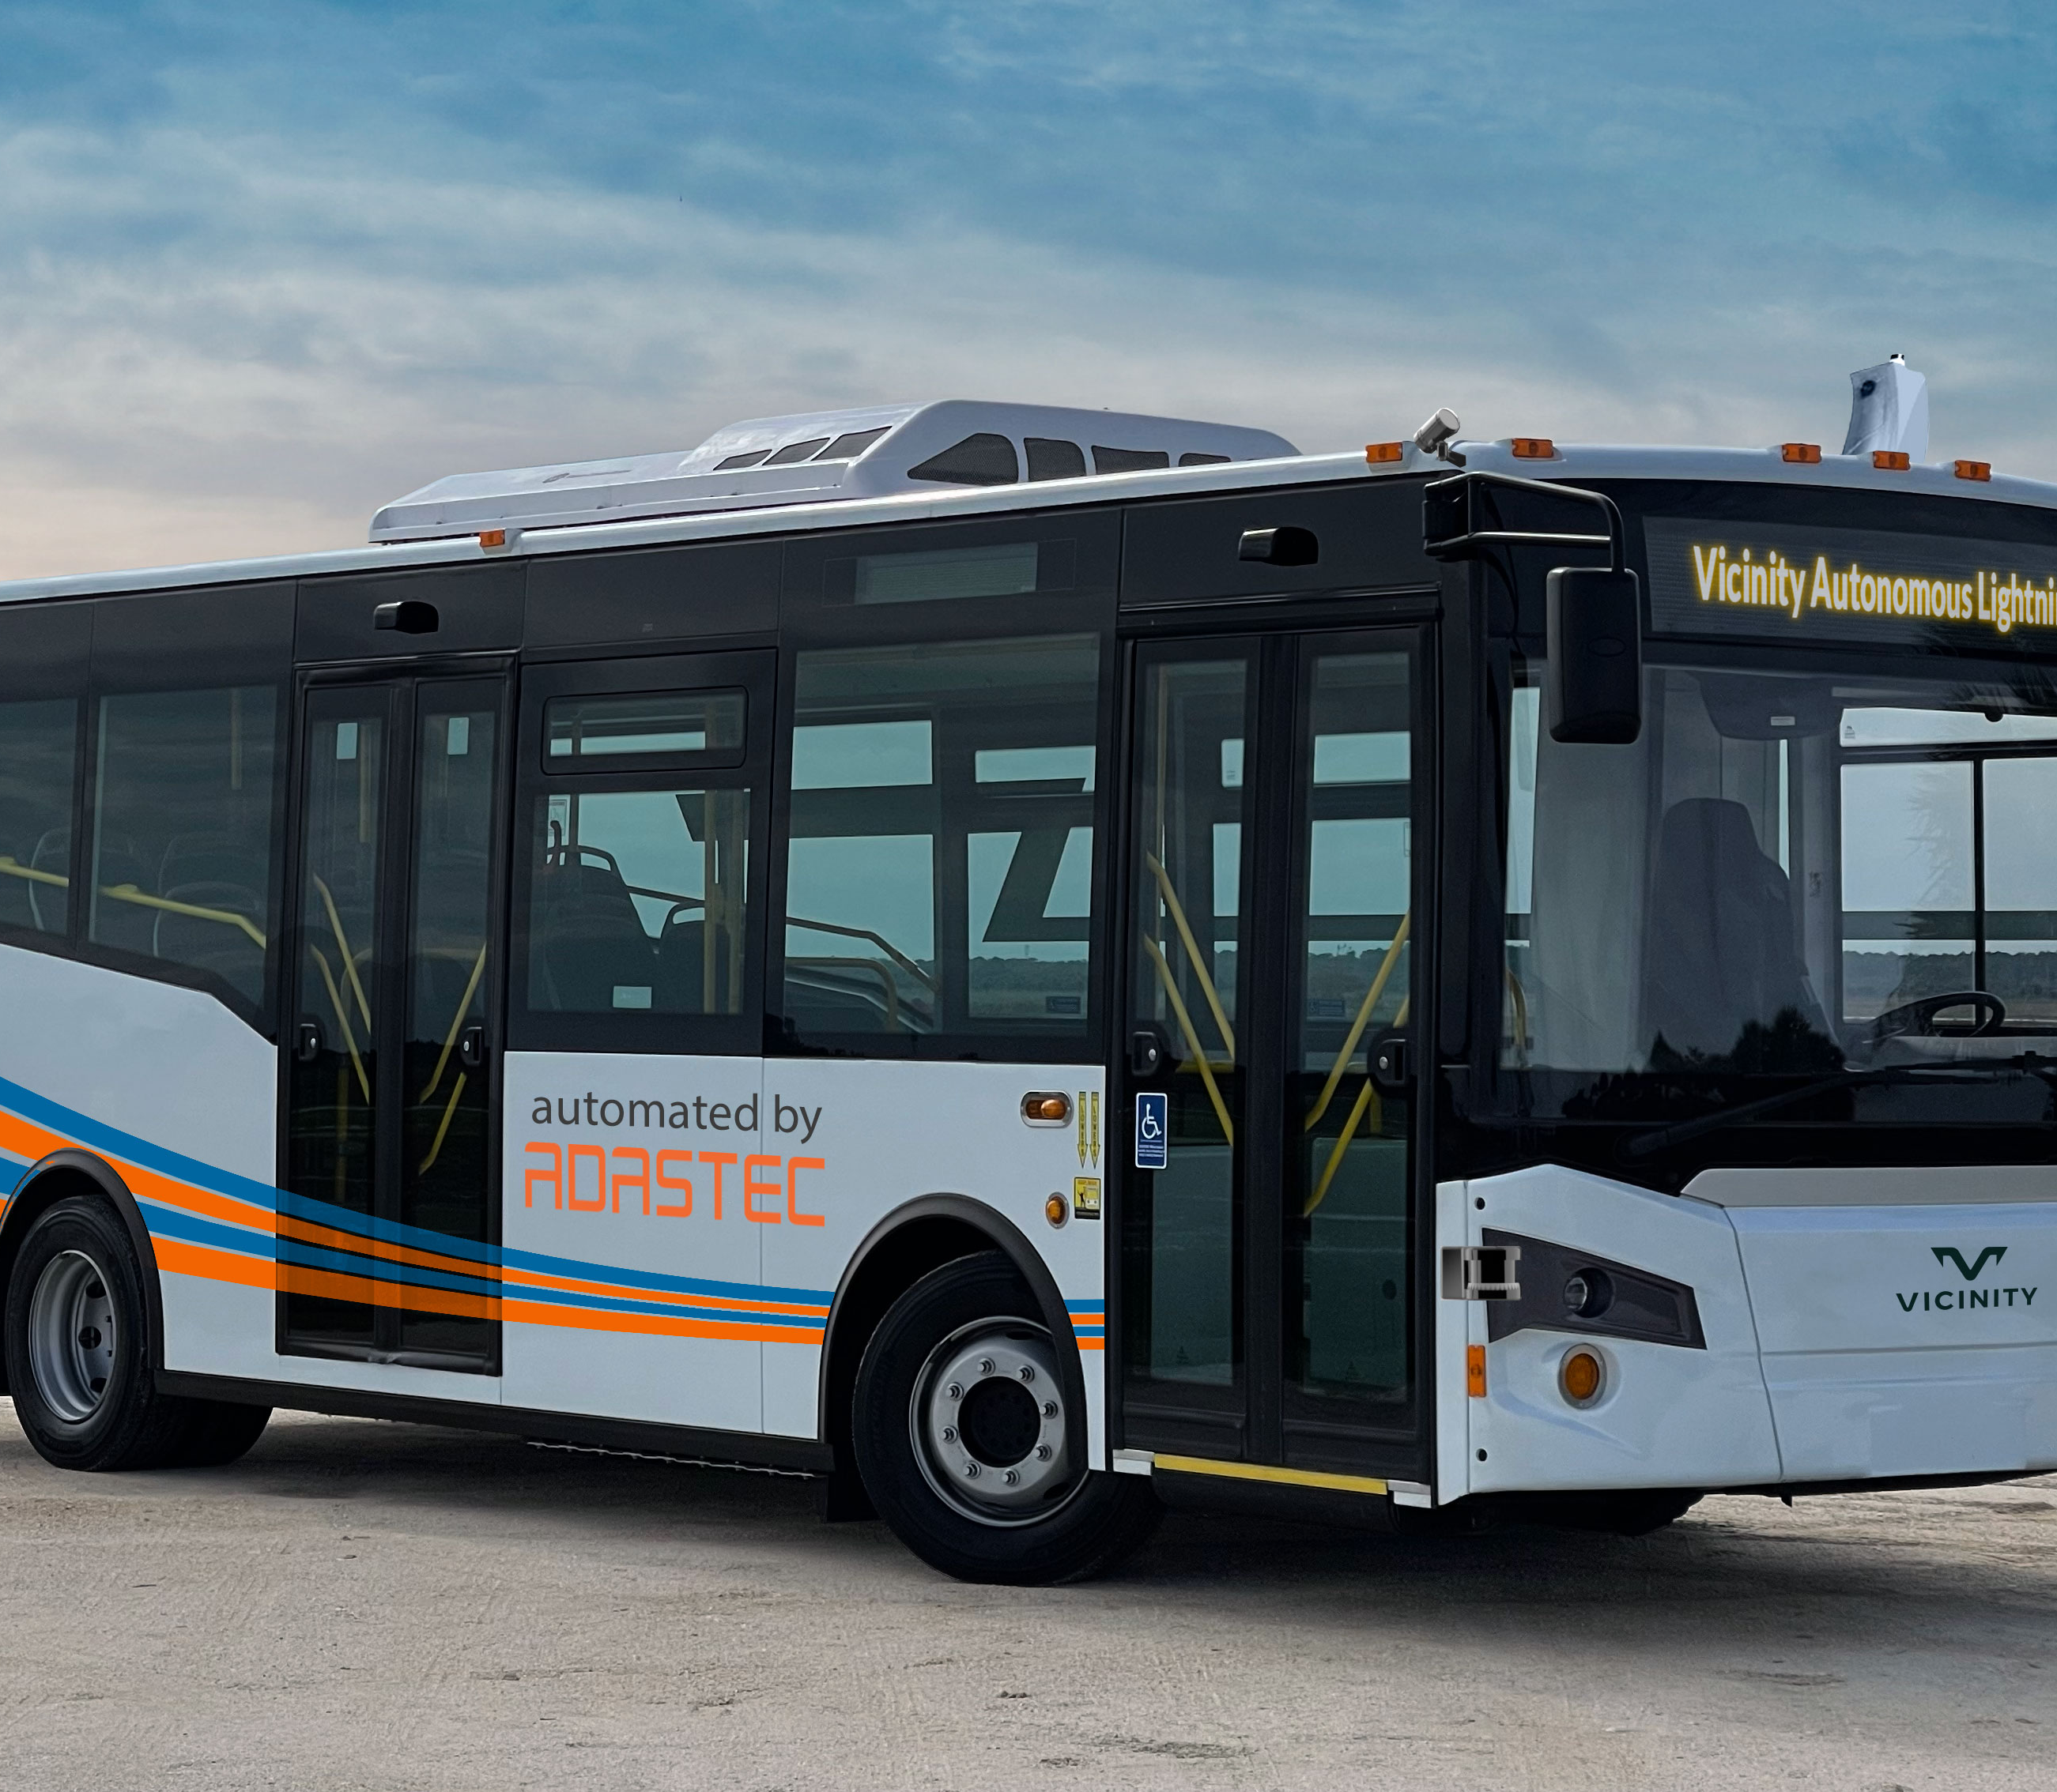
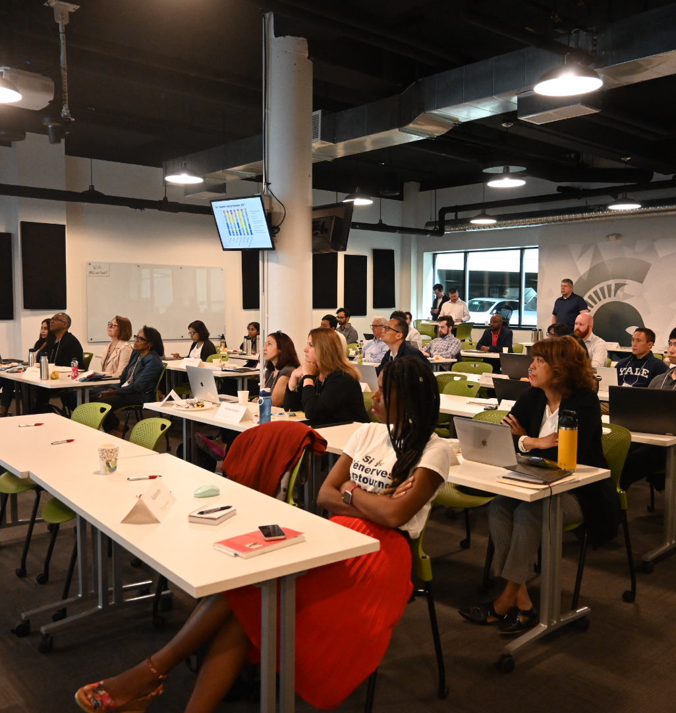
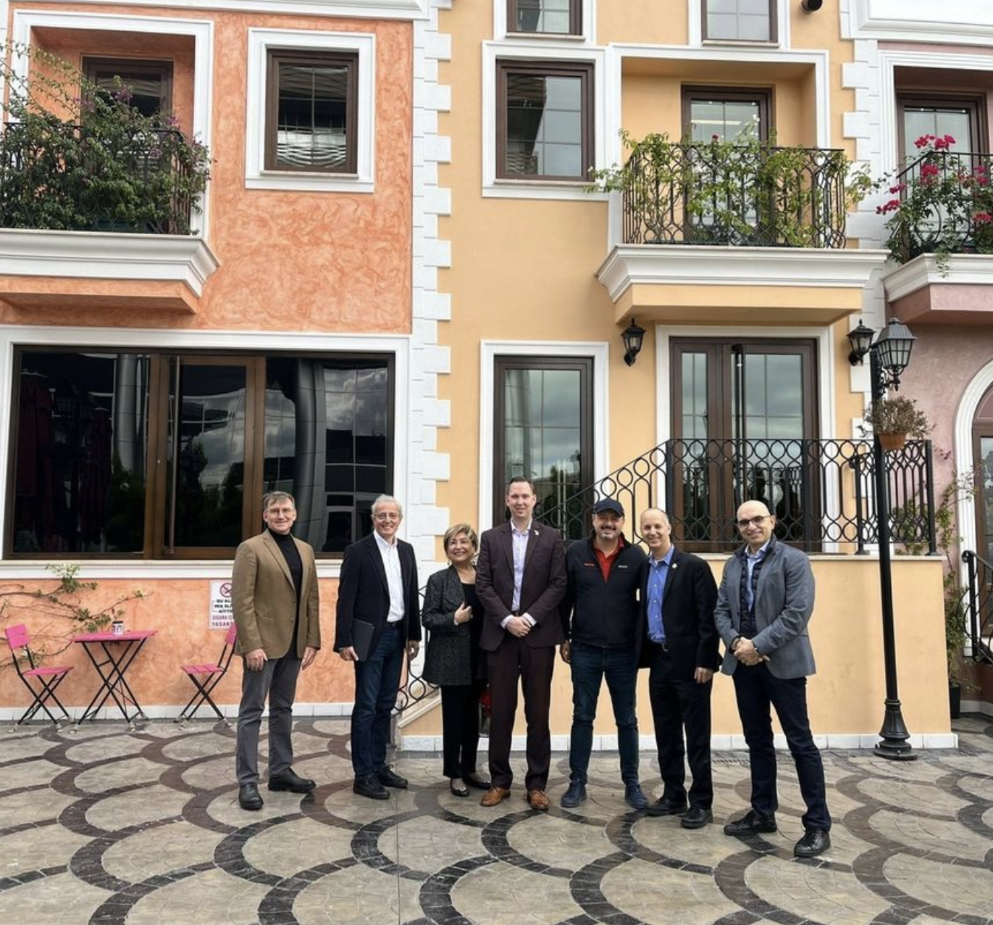
SUBSTANTIAL STARTUPS
ADASTEC (autonomous bus pilot with MSU, LEAP visited in Istanbul 2022)
Innovative (EDA Medtech VentureWell program participant)
Translational Osteosynthesis
Magsorbeo
Isaab Innovations

Slide 6
LEAP ENTREPRENEURIAL ACTIVITY
Drastically improved physical space occupancy of East Lansing’s Technology Innovation Center (TIC) from 30% to 80%
$72,170 – Business Accelerator Funds (BAF) Deployed in Total
27,170 – SCOPS Coating
15,000 – MotMot
10,000 – CoolGlass
$20,000 – Discretionary BAF
$93,000 – Local Accelerator Funds (LAF) Deployed across 27 transactions
Elevate
9 participants in cohort, that since start of program:
$500,000+ in new business revenue
3 started offering a new product or service
2 commenced brick&mortar location
5 have seen boost in social media traffic
One and All – total of 20 participants in cohort 7, all 19 graduated
12 participants identify as women
7 participants identify as BIPOC
6 participants as having varying levels of ability
1 participant identifies as LGBTQ+
1 participant identifies as a refugee
1 participant identifies as a veteran
LevelUp – assisted 5 LLC Creations, 9 accounting systems adopted, 19 covenant documents created, 2 financial projections developed

Slide 7
2023 PROGRAMMATIC ACHIEVEMENTS
SmartZone (EIT) with new first-time Executive Director (LEAP) performed at new high levels
DEEP strong diversity programming
Record-level site prospects/on global site visits – Second Place Finishes, but highly competitive
Ultium Diversity/Work Force Development (Partners CAMW!, LCC, Piper & Gold. MEDC/LEO)
Secured a $150,000 regional childcare coalition planning grant and then an additional $91,515 for deeper implementation, leader in state
Built region’s first-ever interactive GIS future land use & zoning map for future development planning in housing, commercial, industrial, etc.
Developed collaboratively with key partners (especially Sparrow, MSU and NEOGEN) a brand for the region’s MedTech and life sciences industry cluster, now dubbed “Michigan’s Health Core” with new website and marketing content
Administered $4 million in state site readiness funds to prepare our region’s best sites for future development

Slide 8
PREPARING FOR 2024
$3.5 million Historic –level Entrepreneurial grant for three counties
$500,000 Three County Rural Connections/Attraction grant
$500,000 Diversity/Small Business Three County state appropriation
Landed a $1.2 million Industrial Site Readiness grant for 2024
Applied for largest ever EPA Brownfield Assessment coalition-style grant for entire tri-county region, $1.5M if awarded
Developed the region’s first semiconductor industry cluster action plan
Developed region’s first agricultural technology (AgTech), food processing and agribusiness industry report, emphasizing M-21 AgTech Corridor and MSU as key assets
Submitted for $6 million+ additional industrial site readiness grant
Full MedTech activation
Business Ecosystem (childcare, housing) continues

Slide 9
OTHER OBSERVATIONS
The economy going great but tougher for financial, housing and commercial real estate business
ARPA federal funding ending – Ramifications for public budgets
2023 near misses, but the Lansing region is now a full-fledged global competitor for major businesses and jobs
Available land for large industrial development or needed new single-family home housing developments of mass scale is diminished
The state needs to give final approval to substantial economic incentive packages
Slow down, yes, with electric car/battery production, but the industry is inevitable and we are poised very well – same for semiconductor
Need to continue to diversify the regional economy – startups/entrepreneurialism
State/our region needs to radically keep/attract new population growth

Slide 10
Thank You!

