Slide 1
NAME OF PRESENTATION HERE
NAME HERE / OCTOBER 2014

Slide 2
MEDC Organizational Chart

Slide 3
Business Development Overview
Retention & Growth
Global Business Development
Sales Operations & Support Services
Business Incentives & Capital Markets
Pure Michigan Business Connect
Planet M
International Trade
Entrepreneurship & Innovation

Slide 4
Retention & Growth Team
20 Team Members
16 BDM’s
2 Regional Directors
1 Vice President
1 CDC Liaison
Retention Visits
Project Visits
Customer Support Visits
2,523 Total Visits in FY17 (Oct. 2016 – Sept. 2017)
85% of our Total Successful Projects

Slide 5
Business Development Managers Territory Map

Slide 6
Who knows Brenda Flory?
91 Visits in Isabella and Clare Counties in FY17
278 Total Visits in Region 5
5 Successful Projects in Region 5
251 New Jobs
$596.6 M in New Capital Investment

Slide 7
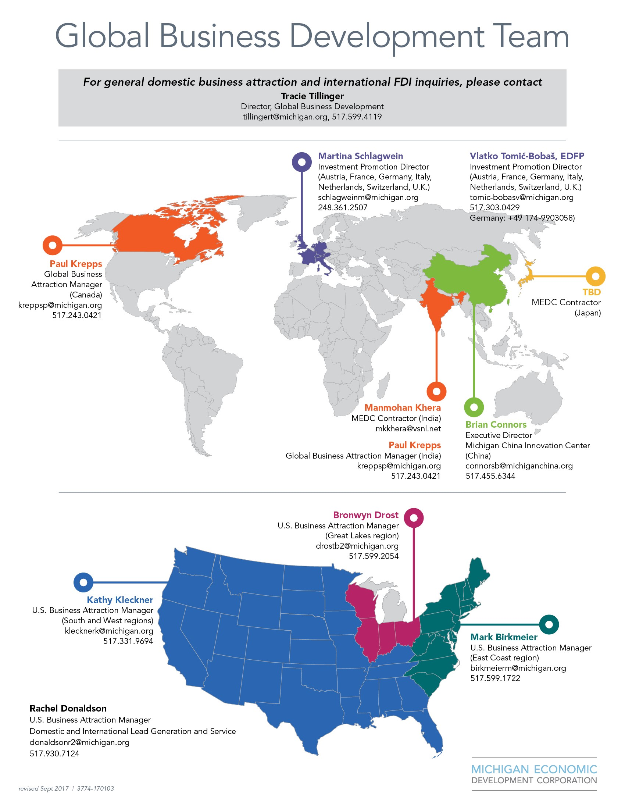

Slide 8
Global Business Development Team
10 Team Members
Target Market Focused
Target Industry Focused
Automotive/Mobility
Agriculture
Aerospace
Life Sciences
IT/Software/Data Centers
Headquarters Visits
Delfied and Unified Brands
Lead Generation Focused
Converting Leads to Projects
Handoff Projects to BDM’s

Slide 9
Sales Operations & Support Services Team
15 Team Members
RFP’s and RFI’s
Why Michigan Proposals
Target Industry Sector Intelligence
Target Companies to Pursue outside of Michigan
Sales Sheets focused on Industries and Michigan Business Climate
Tax Abatement Estimates
Business Background Checks
Incentive Offer Letters preparation
Site Consultants

Slide 10
Site Consultants Focus
335 Site Consultants Nationwide
6 Market Blitz’s
Atlanta – Nov. 2017
Germany – Dec. 2017
Illinois – March 2018
Ohio – April 2018
Dallas – May 2018
Indiana – July 2018
3 Familiarization Tours
Detroit – June 2018
Grand Rapids – August 2018
Northern Michigan – Sept. 2018

Slide 11
Business Incentives & Capital Markets Team
Business Development Program (BDP)
Performance-based Cash Grants
Job Creation and Private Investment Requirements
Mini-BDP Program
Good Jobs for Michigan Incentive Program
Community Development Block Grant Program
Spec. Building Program
Collateral Support Program
Loan Participation Fund
Capital Access Fund
Private Activity Bond Financing

Slide 12
Pure Michigan Business Connect
Connecting Michigan Buyers with Michigan Suppliers.
150 PMBC Buyer/Supplier Summits held in Michigan since 2011.
More than $5.4 Billion of Facilitated Revenue.
One Job is Created for Every $200,000 of Increased Michigan Procurement Spending.
Pure Michigan Aerospace Summit
February 21, 2018
Detroit

Slide 13
Planet M
Michigan’s Mobility Branding and Awareness Campaign.
Building a Planet M Team at MEDC.
Focus on connecting major automotive companies with smaller I.T., software and communications companies.
Promoting Michigan’s Mobility Assets
American Center for Mobility, Mcity, LIFT, IACMI
Contractor in Silicon Valley to identify company projects opportunities for Michigan, from the west coast.

Slide 14
International Trade Team
Assisting Michigan Companies with Export Market Opportunities
State of Michigan Foreign Trade Center Office Locations
Canada
Mexico
Brazil
U.K.
Dubai
China
Affiliate Trade Center Locations
South America
South Africa
India
Southeast Asia
Australia

Slide 15
International Trade Team
Trade Missions: 1-on-1 Meetings set up for Michigan Companies by the International Trade Team and Foreign Office Directors.
State Trade Expansion Program (STEP)
Grant program to help off-set costs to businesses who are seeking to pursue new export markets.
Eligible Activities:
Overseas Trade Mission Participation
International or Domestic Trade Show Participation
Foreign Market Sales Trips
U.S. Department of Commerce Services
Website and/or Marketing Material Translation Services
Agent, Distributor and/or Customer Searches
Foreign Market Research

Slide 16
Entrepreneurship & Innovation Team
Early Growth Stage Companies, with Rapid Growth Potential
Technology Company Focus Only
Works with Michigan Venture Capital Companies
University Research – Commercialization into the Marketplace
Works with CMURC, and other SmartZones throughout Michigan
Emerging Technology Fund
SBIR
STTR

Slide 17
Cooperation & Communication
Main Point of Contact – Brenda Flory
Regular meetings with MEDC staff
Regional CDC Meetings
Joint Retention Visits
Out-of-State HQ visits

Slide 18
Trends We Are Seeing…….
Expansion projects and new development opportunities continue to come our way.
It’ not slowing down…..18 new projects identified since Oct. 1, 2017.
Projects continue to be smaller on the job creation side, but with larger capital investments being made, compared to past projects.
Existing buildings are very hard to find.
Identifying and finding TALENT still remains everyone’s #1 challenge.

Slide 19
Questions?
THANK YOU!!!!
Tino Breithaupt
Senior Vice President
National & Global Business Development
MEDC
Cell: (231) 620-1565
Email: breithauptt@michigan.org

